Slide 1
Introduction to OGC API Common 30 May 2019
Open Geospatial Consortium

Slide 2
Scope
This specification identifies resources, captures compliance classes, and specifies requirements which are applicable to all OGC API standards. It should be included as a normative reference by all such standards.

Slide 3
The Landing Page
The starting point for navigating an API
Returned by “GET /”
Provides links to
The `API definition` (path `/api`),
The `Conformance` statements (path `/conformance`),
Metadata about the `Collections` metadata (path `/collections`).
Landing Page Schema

Slide 4
API Definition
Only OpenAPI 3.0 is currently supported
Other options may be added in the future
OpenAPI Introduction

Slide 5
Conformance
Identifies the standards and optional conformance classes supported by this API
Returned by “GET /conformance”
Returned document is a list of URIs for the conformance classes
Conformance Schema

Slide 6
Collections
The starting point for the resource-specific paths
Returned by “GET /collections”
Returned document contains:
A link to itself
A link to each alternate encoding of the document
An array of Collection Metadata records
Collections Schema

Slide 7
Collection Metadata
Describes a collection
Included in the Collections response
Returned by “GET /collections/{collectionId}”
Metadata includes:
A local identifier for the collection that is unique for the dataset
A list of coordinate reference systems (CRS) in which geometries may be returned by the server
An optional title and description for the collection
An optional extent that can be used to provide an indication of the spatial and temporal extent of the collection - typically derived from the data.
Collection Metadata Schema

Slide 8
Extent
Defines a spatial-temporal boundary for the collection
Spatial extent is a bounding box.
Temporal extent is a date-time or a period.
May include spatial and temporal CRS.
Extent Schema

Slide 9
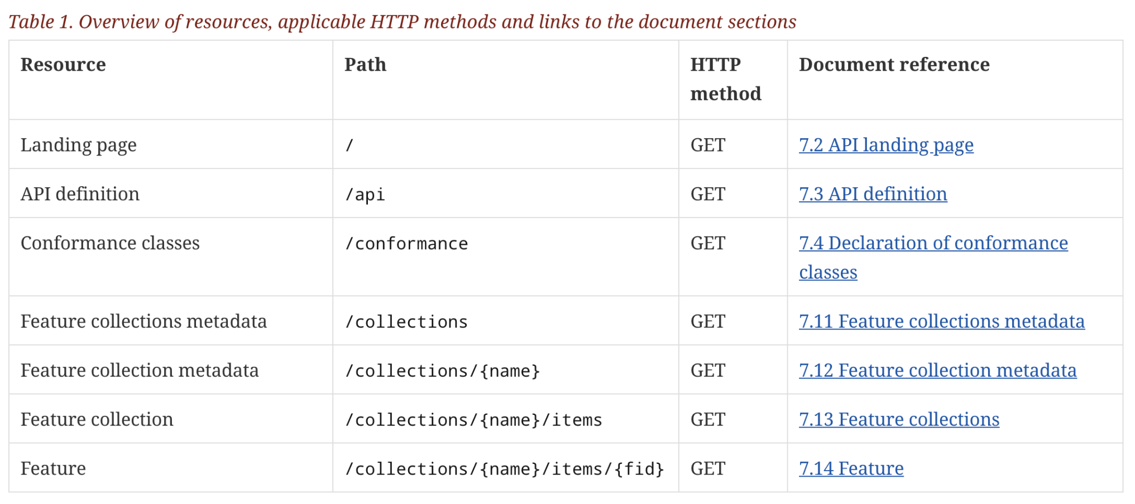
API Common- Features
information
about the API
a dataset with a sub-division into
named collections of features
the features
https://cdn.rawgit.com/opengeospatial/WFS_FES/3.0.0-draft.1/docs/17-069.html#tldnr
Only the feature resources are specific to a “feature service”

Slide 10
cheazel@wiscenterprises.com
Questions?

